Slide 1




CSE224-Digital Logic Design Lab
Title
Team
Introduction
Circuit
Working
Applications
Conclusion
Super Sensitive Intruder Alarm
PROJECT PRESENTATION
Presented to -
Mr. Shoumik Debnath
Lecturer,
Department of CSE
Daffodil International University

Slide 2
Title
Team
Introduction
Circuit
Working
Applications
Conclusion
Super Sensitive Intruder Alarm
OUR TEAM
Group4
65_D1
SUPAN ROY
ID: 232-15-716
ABDULLAH AL NOMAN
ID: 232-15-797
NUR SAYDA
ID: 232-15-437
MD. SHAHINUR KABIR ANTOR
ID: 232-15-159
SHAKIRA RAHMAN SIMI
ID: 232-15-723

Slide 3
Title
Team
Introduction
Circuit
Working
Applications
Conclusion
Super Sensitive Intruder Alarm
Introduction
🔸In today’s world, security is a major concern for homes, offices, and restricted areas.
🔸Our project focuses on building a cost-effective and highly sensitive intruder alarm system using basic
electronic components.
🔸The system uses infrared (IR) technology to detect motion or interruption in the IR beam.
🔸When someone blocks it, the alarm turns on, the system triggers a buzzer to alert about the intrusion.
🔸This kind of setup can help improve safety and awareness in any environment.
🔸This project is ideal for beginners and can be expanded for real-life security applications.

Slide 4

Super Sensitive Intruder Alarm
Title
Team
Introduction
Circuit
Working
Applications
Conclusion
Components Used
NE555 Timer IC
LM358 Operational Amplifier (Op-Amp)
10K Preset/Variable resistor
IR Transmitter
IR Receiver
Red LED
Electrolytic Capacitor (10uF, 50V)
Resistors: 10KΩ, 1KΩ, 100KΩ, 220Ω
Buzzer
Breadboard
Connecting Wires Multiple
5V Power Supply

Slide 5
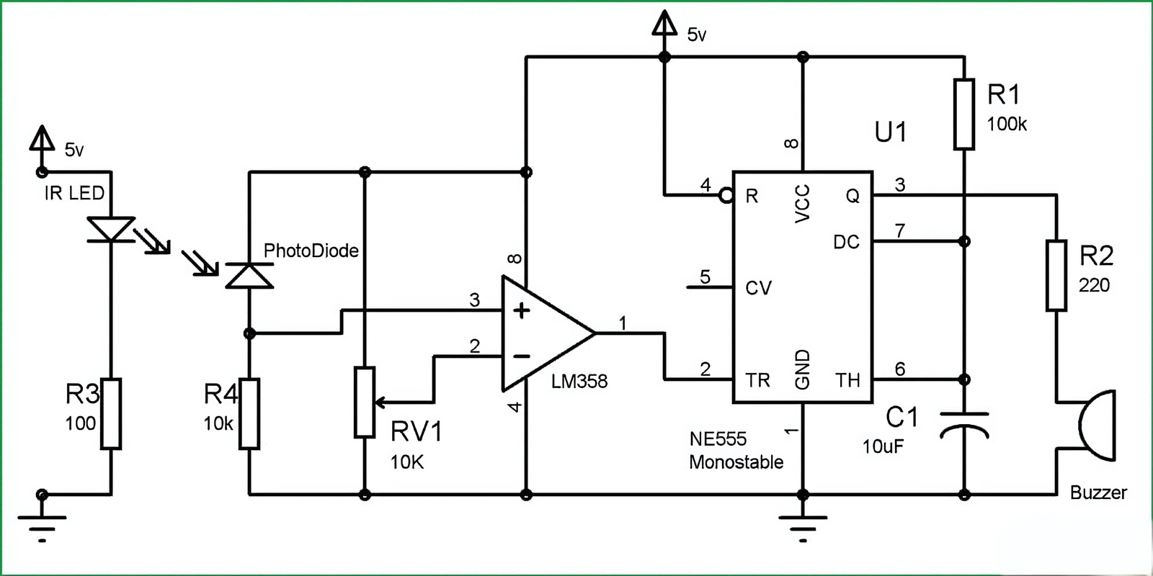
Super Sensitive Intruder Alarm
Title
Team
Introduction
Circuit
Working
Applications
Conclusion
Circuit Diagram
Fig. 1.1: Super Sensitive Intruder Alarm Circuit

Slide 6
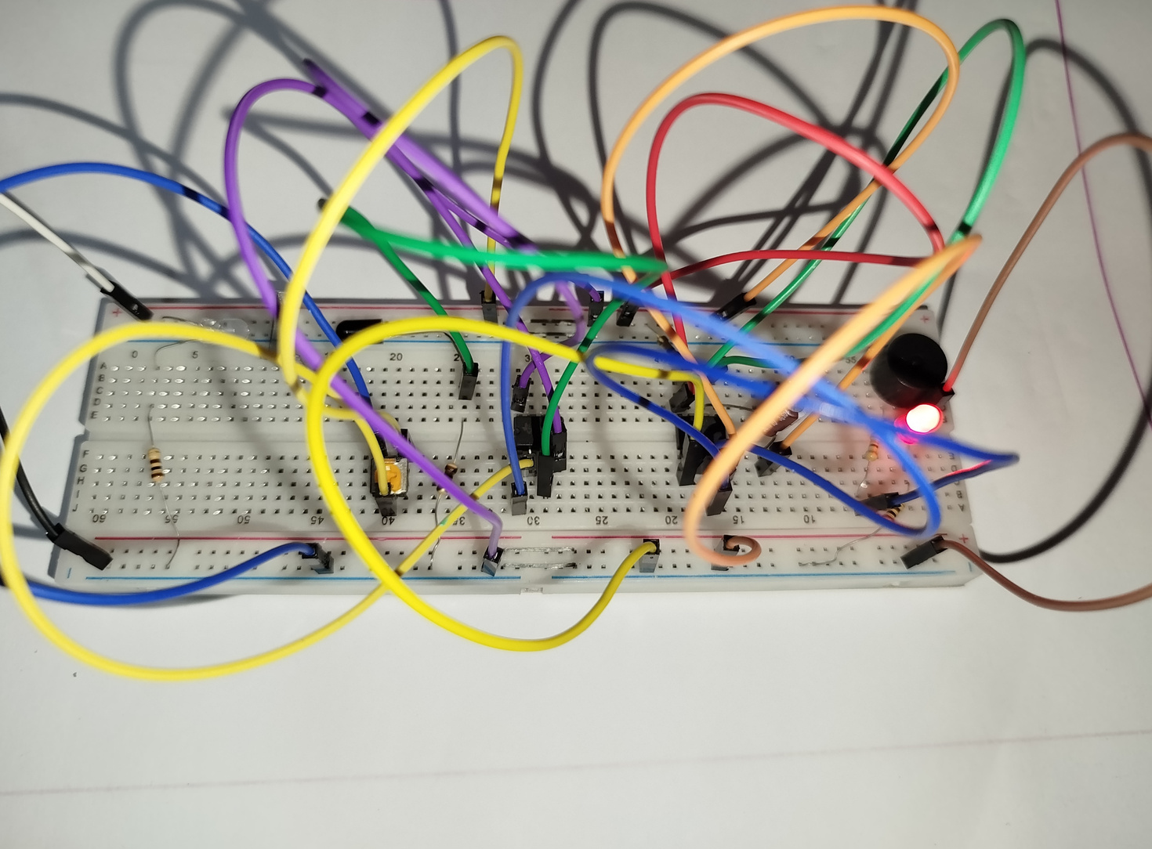
Super Sensitive Intruder Alarm
Title
Team
Introduction
Circuit
Working
Applications
Conclusion
Project Prototype
Fig. 1.2: Super Sensitive Intruder Alarm Circuit

Slide 7
Super Sensitive Intruder Alarm
Title
Team
Introduction
Circuit
Working
Applications
Conclusion
Working Principle
⚙️ 1. IR Transmitter Section
IR LED emits invisible infrared light continuously.
100Ω Resistor (R3) limits current to protect the IR LED.
Light beam is aimed at the photodiode across the sensing area.
Fig. 2.1: IR Transmitter

Slide 8

Title
Team
Introduction
Circuit
Working
Applications
Conclusion
Super Sensitive Intruder Alarm
Working Principle
👁️ 2. IR Receiver & Comparator Section
Photodiode is in reverse bias: receives IR light and allows reverse current.
10kΩ Resistor (R4) works as a pull-down resistor, creating a voltage drop based on IR light intensity.
10kΩ Preset (RV1) sets a fixed reference voltage at LM358’s inverting input.
LM358 Op-Amp (Comparator) compares:
Pin 3 (+): voltage from photodiode
Pin 2 (–): reference from preset
When someone blocks IR beam:
Photodiode voltage increases (Pin 3 > Pin 2)
Comparator output (Pin 1) goes LOW to HIGH, triggering next stage
Fig. 2.2: IR Receiver and Op-Amp (LM358)

Slide 9

Title
Team
Introduction
Circuit
Working
Applications
Conclusion
Super Sensitive Intruder Alarm
Working Principle
⏱️ 3. Monostable Timer Section (555 IC)
NE555 Timer is configured in monostable mode.
Trigger Pin (Pin 2) is activated by LM358 output.
100kΩ Resistor (R1) and 10µF Capacitor (C1) define the ON-time.
On trigger:
Pin 3 (Output) goes HIGH for a fixed duration.
Timer resets automatically after time interval ends.
Fig. 2.3: 555 Timer IC

Slide 10
Title
Team
Introduction
Circuit
Working
Applications
Conclusion
Super Sensitive Intruder Alarm
Working Principle
🔔 4. Output Section (Buzzer)
220Ω Resistor (R2) limits current to the Buzzer.
When 555 output is HIGH:
Buzzer turns ON
Produces alert sound indicating intrusion
🔋 Power Supply:
Whole circuit operates on +5V DC supply.
All ICs and components are powered from this single source.
Fig. 2.4: Buzzer Output

Slide 11

Super Sensitive Intruder Alarm
Title
Team
Introduction
Circuit
Working
Applications
Conclusion
Applications & Future Improvements
✅ Applications:
🔹 Home Security Systems
Used at doors, windows, or hallways to detect unauthorized entry.
🔹 Bank & ATM Booths
Alerts security when someone enters during off-hours.
🔹 Warehouses & Storage Units
Protects valuable goods from theft by detecting movement.
🔹 School Labs or Server Rooms
Restricts access to sensitive areas when unsupervised.
🔹 Automatic Lighting Systems
Can be adapted to turn on lights when someone enters a room.

Slide 12
Title
Team
Introduction
Circuit
Working
Applications
Conclusion
Super Sensitive Intruder Alarm
Applications & Future Improvements
🔄 Future Improvements:
🔸 Add SMS or Call Alert feature using GSM module.
🔸 Integrate with CCTV systems for real-time footage during intrusion.
🔸 Make it battery powered for portability and use during power cuts.
🔸 Add Wi-Fi or IoT support to control and monitor via smartphone.
🔸 Use motion sensors or camera-based detection for more accuracy.

Slide 13
Super Sensitive Intruder Alarm
Title
Team
Introduction
Circuit
Working
Applications
Conclusion
🎓 Learning Outcomes
🔹 Understanding Real-world Problem Solving
We learned how basic electronics can be applied to real-life security issues in a cost-effective way.
🔹 Circuit Design & Implementation
We gained hands-on experience building a working circuit using sensors, op-amps, and timers.
🔹 Sensor Technology
Understood how IR sensors work and how they can be used to detect objects or people non-contact.
🔹 Comparator and Timer Logic
Learned how a comparator (LM358) compares voltages and how a 555 timer functions in
monostable mode.
🔹 Troubleshooting & Debugging
Faced practical issues like incorrect wiring, loose connections, and fixed them to make the circuit
stable.

Slide 14
Super Sensitive Intruder Alarm
Title
Team
Introduction
Circuit
Working
Applications
Conclusion
Conclusion
In this project, we successfully designed and implemented a Super Sensitive Intruder Alarm that can detect unauthorized entry using an infrared sensor system. The circuit provides a quick and reliable alert whenever the IR beam is interrupted, making it a practical solution for basic security needs. Through this work, we not only built a functional security system but also gained valuable knowledge about sensor technology, circuit design, and component integration. This project helped strengthen our teamwork and problem-solving abilities, and with future improvements, the system holds potential for real-world applications in homes, schools, and other secure areas.
GIGGLING PLATYPUS CO / TIMMERMAN INDUSTRIES / ALDENAIRE & PARTNERS

Slide 15
Super Sensitive Intruder Alarm
Thank You!
FOR YOUR ATTENTION

